Slide 1




On Line Analytic Processing (OLAP) Pertemuan 10 MK Basis Data
M. N. Fakhruzzaman, S.Kom., M.Sc.
Dr. Maryamah, S.Kom
Program Studi S1 Teknologi Sains Data
Fakultas Teknologi Maju dan Multidisiplin
Universitas Airlangga Indonesia
www.ftmm.unair.ac.id
@ftmmunair
Notes:
sistem basis data merupakan komponen fundamental dari sistem informasi organisasi/perusahaan, db development lifecycle secara melekat terkait dengan siklus hidup sistem informasi.

Slide 2
OLTP Compared With OLAP
On Line Transaction Processing – OLTP
Maintains a database that is an accurate model of some real-world enterprise. Supports day-to-day operations.
Characteristics:
Short simple transactions
Relatively frequent updates
Transactions access only a small fraction of the database
On Line Analytic Processing – OLAP
Uses information in database to guide strategic decisions.
Characteristics:
Complex queries
Infrequent updates
Transactions access a large fraction of the database
Data need not be up-to-date

Slide 3
The Internet Grocer
OLTP-style transaction:
John Smith, from Schenectady, N.Y., just bought a box of tomatoes; charge his account; deliver the tomatoes from our Schenectady warehouse; decrease our inventory of tomatoes from that warehouse
OLAP-style transaction:
How many cases of tomatoes were sold in all northeast warehouses in the years 2000 and 2001?

Slide 4
OLAP: Traditional Compared with Newer Applications
Traditional OLAP queries
Uses data the enterprise gathers in its usual activities, perhaps in its OLTP system
Queries are ad hoc, perhaps designed and carried out by non-professionals (managers)
Newer Applications (e.g., Internet companies)
Enterprise actively gathers data it wants, perhaps purchasing it
Queries are sophisticated, designed by professionals, and used in more sophisticated ways

Slide 5
The Internet Grocer
Traditional
How many cases of tomatoes were sold in all northeast warehouses in the years 2000 and 2001?
Newer
Prepare a profile of the grocery purchases of John Smith for the years 2000 and 2001 (so that we can customize our marketing to him and get more of his business)

Slide 6
Data Warehouses
OLAP and data mining databases are frequently stored on special servers called data warehouses:
Can accommodate the huge amount of data generated by OLTP systems
Allow OLAP queries and data mining to be run off-line so as not to impact the performance of OLTP

Slide 7
OLAP, Data Mining, and Analysis
The “A” in OLAP stands for “Analytical”
Many OLAP and Data Mining applications involve sophisticated analysis methods from the fields of mathematics, statistical analysis, and artificial intelligence
Our main interest is in the database aspects of these fields, not the sophisticated analysis techniques

Slide 8
Fact Tables
Many OLAP applications are based on a fact table
For example, a supermarket application might be based on a table
Sales (Market_Id, Product_Id, Time_Id, Sales_Amt)
The table can be viewed as multidimensional
Market_Id, Product_Id, Time_Id are the dimensions that represent specific supermarkets, products, and time intervals
Sales_Amt is a function of the other three

Slide 9
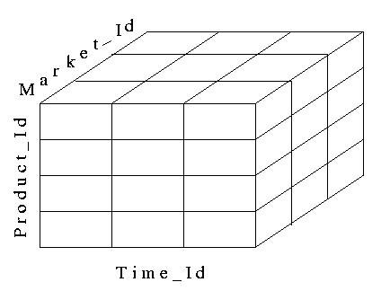
A Data Cube
Fact tables can be viewed as an N-dimensional data cube (3-dimensional in our example)
The entries in the cube are the values for Sales_Amts

Slide 10
Dimension Tables
The dimensions of the fact table are further described with dimension tables
Fact table:
Sales (Market_id, Product_Id, Time_Id, Sales_Amt)
Dimension Tables:
Market (Market_Id, City, State, Region)
Product (Product_Id, Name, Category, Price)
Time (Time_Id, Week, Month, Quarter)

Slide 11
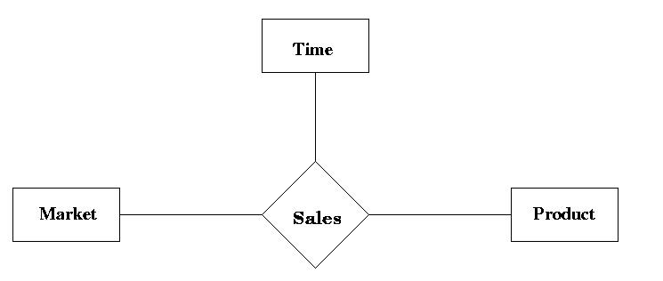
Star Schema
The fact and dimension relations can be displayed in an E-R diagram, which looks like a star and is called a star schema

Slide 12
Aggregation
Many OLAP queries involve aggregation of the data in the fact table
For example, to find the total sales (over time) of each product in each market, we might use
SELECT S.Market_Id, S.Product_Id, SUM (S.Sales_Amt)
FROM Sales S
GROUP BY S.Market_Id, S.Product_Id
The aggregation is over the entire time dimension and thus produces a two-dimensional view of the data

Slide 13
Aggregation over Time
The output of the previous query
Market_Id
SUM(Sales_Amt) | M1 | M2 | M3 | M4
P1 | 3003 | 1503 | …
P2 | 6003 | 2402 | …
P3 | 4503 | 3 | …
P4 | 7503 | 7000 | …
P5 | … | … | …
Product_Id

Slide 14
Drilling Down and Rolling Up
Some dimension tables form an aggregation hierarchy
Market_Id → City → State → Region
Executing a series of queries that moves down a hierarchy (e.g., from aggregation over regions to that over states) is called drilling down
Requires the use of the fact table or information more specific than the requested aggregation (e.g., cities)
Executing a series of queries that moves up the hierarchy (e.g., from states to regions) is called rolling up
Note: In a rollup, coarser aggregations can be computed using prior queries for finer aggregations
Notes:
Ibarat abstraksi, levels of details

Slide 15
Drilling Down
Drilling down on market: from Region to State
Sales (Market_Id, Product_Id, Time_Id, Sales_Amt)
Market (Market_Id, City, State, Region)
SELECT S.Product_Id, M.Region, SUM (S.Sales_Amt)
FROM Sales S, Market M
WHERE M.Market_Id = S.Market_Id
GROUP BY S.Product_Id, M.Region
SELECT S.Product_Id, M.State, SUM (S.Sales_Amt)
FROM Sales S, Market M
WHERE M.Market_Id = S.Market_Id
GROUP BY S.Product_Id, M.State,

Slide 16
Rolling Up
Rolling up on market, from State to Region
If we have already created a table, State_Sales, using
SELECT S.Product_Id, M.State, SUM (S.Sales_Amt)
FROM Sales S, Market M
WHERE M.Market_Id = S.Market_Id
GROUP BY S.Product_Id, M.State
then we can roll up from there to:
2. SELECT T.Product_Id, M.Region, SUM (T.Sales_Amt)
FROM State_Sales T, Market M
WHERE M.State = T.State
GROUP BY T.Product_Id, M.Region

Slide 17
Pivoting
When we view the data as a multi-dimensional cube and group on a subset of the axes, we are said to be performing a pivot on those axes
Pivoting on dimensions D₁,…,D_{k} in a data cube D₁,…,D_{k},D_{k+1},…,D_{n} means that we use GROUP BY A₁,…,A_{k} and aggregate over A_{k+1},…A_{n}, where A_{i} is an attribute of the dimension D_{i}
Example: Pivoting on Product and Time corresponds to grouping on Product_id and Quarter and aggregating Sales_Amt over Market_id:
SELECT S.Product_Id, T.Quarter, SUM (S.Sales_Amt)
FROM Sales S, Time T
WHERE T.Time_Id = S.Time_Id
GROUP BY S.Product_Id, T.Quarter
Pivot

Slide 18
Slicing-and-Dicing
When we use WHERE to specify a particular value for an axis (or several axes), we are performing a slice
Slicing the data cube in the Time dimension (choosing sales only in week 12) then pivoting to Product_id (aggregating over Market_id)
SELECT S.Product_Id, SUM (Sales_Amt)
FROM Sales S, Time T
WHERE T.Time_Id = S.Time_Id AND T.Week = ‘Wk-12’
GROUP BY S. Product_Id
Slice
Pivot

Slide 19
Slicing-and-Dicing
Typically slicing and dicing involves several queries to find the “right slice.”
For instance, change the slice and the axes:
Slicing on Time and Market dimensions then pivoting to Product_id and Week (in the time dimension)
SELECT S.Product_Id, T.Quarter, SUM (Sales_Amt)
FROM Sales S, Time T
WHERE T.Time_Id = S.Time_Id
AND T.Quarter = 4
AND S.Market_id = 12345
GROUP BY S.Product_Id, T.Week
Slice
Pivot

Slide 20
The CUBE Operator
To construct the following table, would take 3 queries (next slide)
Market_Id
SUM(Sales_Amt) | M1 | M2 | M3 | Total
P1 | 3003 | 1503 | … | …
P2 | 6003 | 2402 | … | …
P3 | 4503 | 3 | … | …
P4 | 7503 | 7000 | … | …
Total | … | … | … | …
Product_Id

Slide 21
The Three Queries
For the table entries, without the totals (aggregation on time)
SELECT S.Market_Id, S.Product_Id, SUM (S.Sales_Amt)
FROM Sales S
GROUP BY S.Market_Id, S.Product_Id
For the row totals (aggregation on time and supermarkets)
SELECT S.Product_Id, SUM (S.Sales_Amt)
FROM Sales S
GROUP BY S.Product_Id
For the column totals (aggregation on time and products)
SELECT S.Market_Id, SUM (S.Sales)
FROM Sales S
GROUP BY S.Market_Id

Slide 22
Definition of the CUBE Operator
Doing these three queries is wasteful
The first does much of the work of the other two: if we could save that result and aggregate over Market_Id and Product_Id, we could compute the other queries more efficiently
The CUBE clause is part of SQL:1999
GROUP BY CUBE (v1, v2, …, vn)
Equivalent to a collection of GROUP BYs, one for each of the 2^{n} subsets of v1, v2, …, vn

Slide 23
Example of CUBE Operator
The following query returns all the information needed to make the previous products/markets table:
SELECT S.Market_Id, S.Product_Id, SUM (S.Sales_Amt)
FROM Sales S
GROUP BY CUBE (S.Market_Id, S.Product_Id)

Slide 24
Materialized Views
The CUBE operator is often used to precompute aggregations on all dimensions of a fact table and then save them as a materialized views to speed up future queries

Slide 25
ROLAP and MOLAP
Relational OLAP: ROLAP
OLAP data is stored in a relational database as previously described. Data cube is a conceptual view – way to think about a fact table
Multidimensional OLAP: MOLAP
Vendor provides an OLAP server that implements a fact table as a data cube using a special multi-dimensional (non-relational) data structure

Slide 26
MOLAP
No standard query language for MOLAP databases
Many MOLAP vendors (and many ROLAP vendors) provide proprietary visual languages that allow casual users to make queries that involve pivots, drilling down, or rolling up

Slide 27
Implementation Issues
OLAP applications are characterized by a very large amount of data that is relatively static, with infrequent updates
Thus, various aggregations can be precomputed and stored in the database
Star joins, join indices, and bitmap indices can be used to improve efficiency (recall the methods to compute star joins in Chapter 14)
Since updates are infrequent, the inefficiencies associated with updates are minimized

Slide 28
Terima Kasih
www.ftmm.unair.ac.id
@ftmmunair

